Slide 1
throw keyword in java?
momedaram

Slide 2
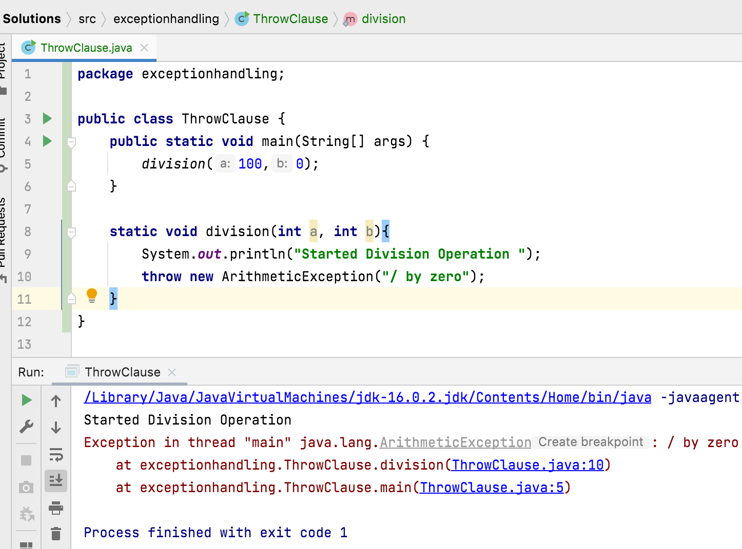
Sometimes we can create Exception object explicitly and we can hand over to the JVM manually by using throw keyword.
Syntax: throw InstanceOfThrowableType;

Slide 3
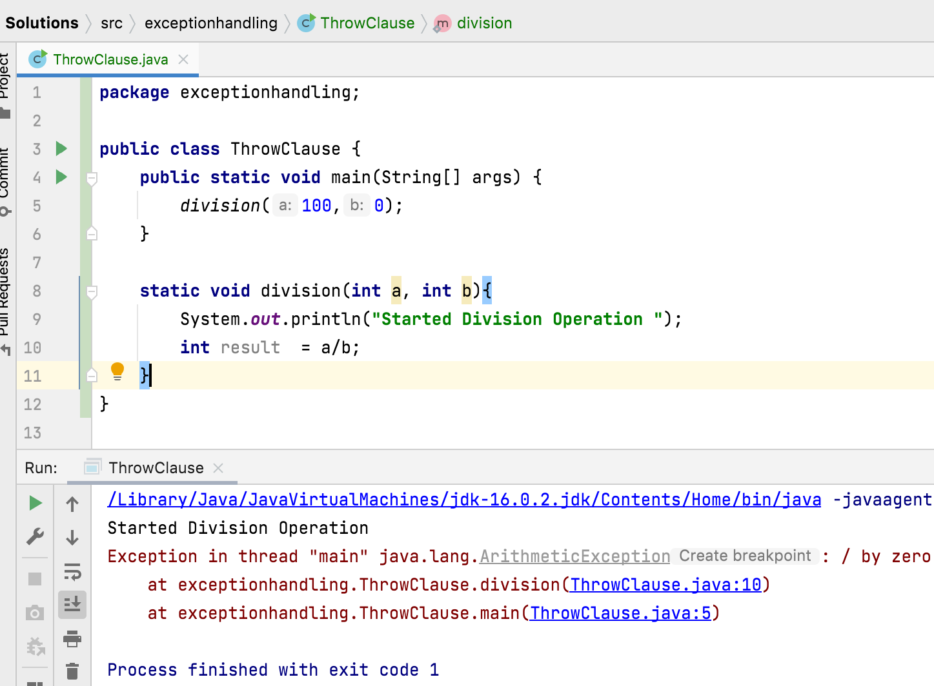
In general, we can use throw keyword for customized exceptions but not for predefined exceptions.

Slide 4
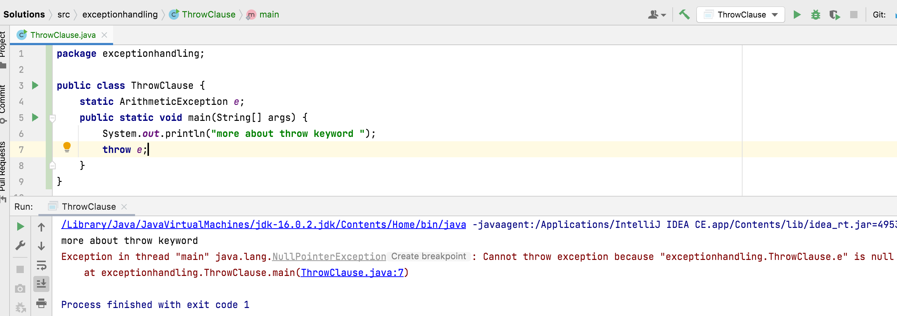
If exception object of throw clause refers null, then we will get NullPointerException.

Slide 5
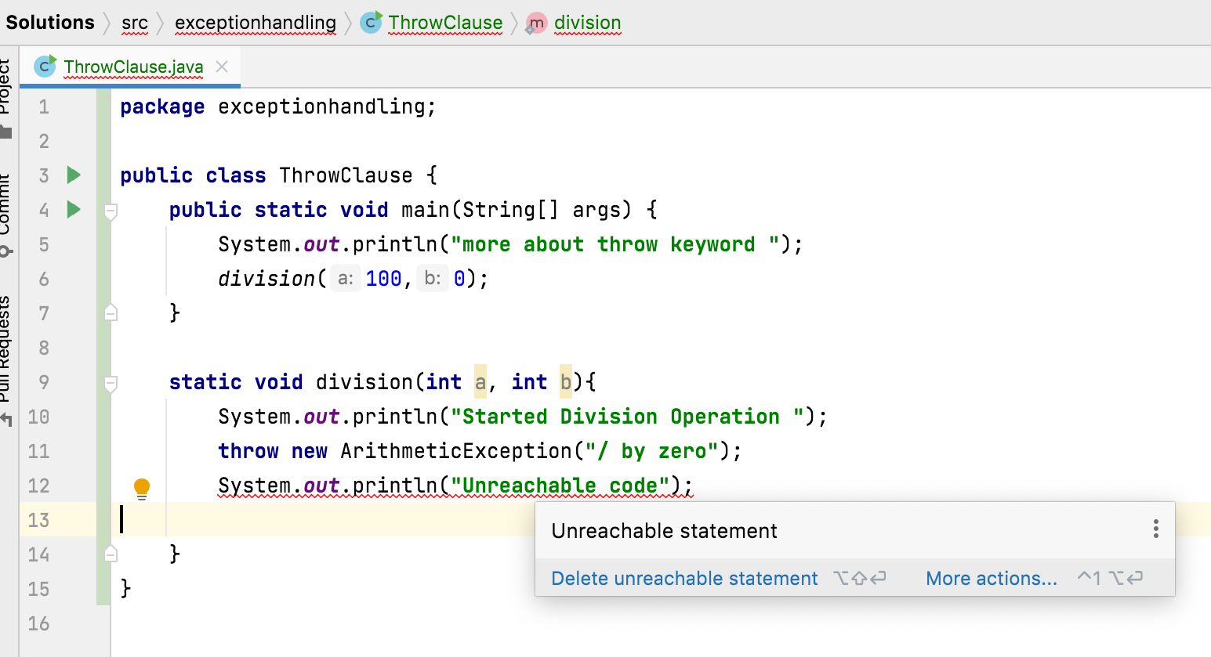
We can not keep any statements after throw statement, if we keep then we will get compile time error saying unreachable statement.

Slide 6
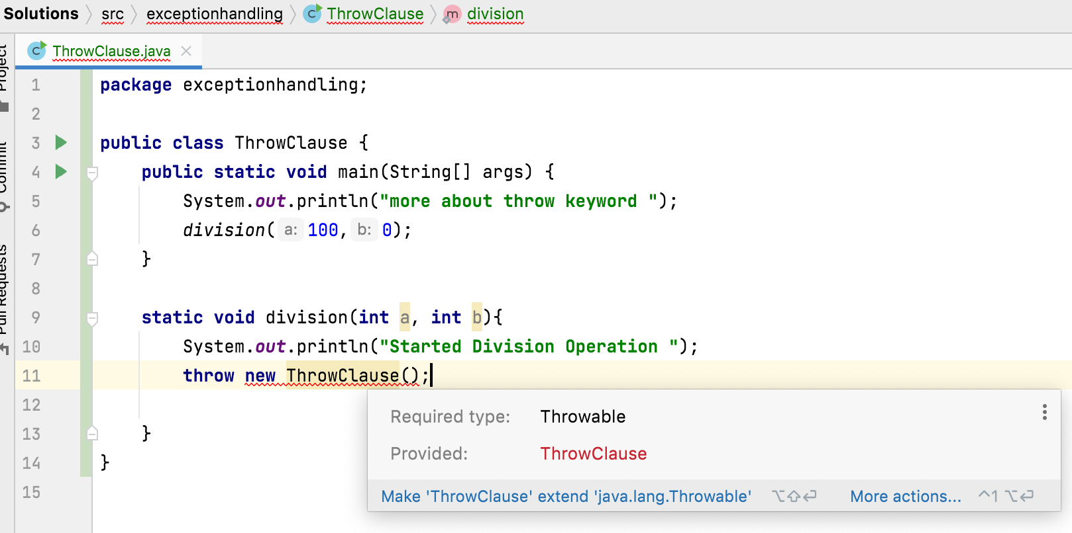
We can use throw keyword only for Throwable types otherwise we will get compile time error saying incomputable types.

Slide 7
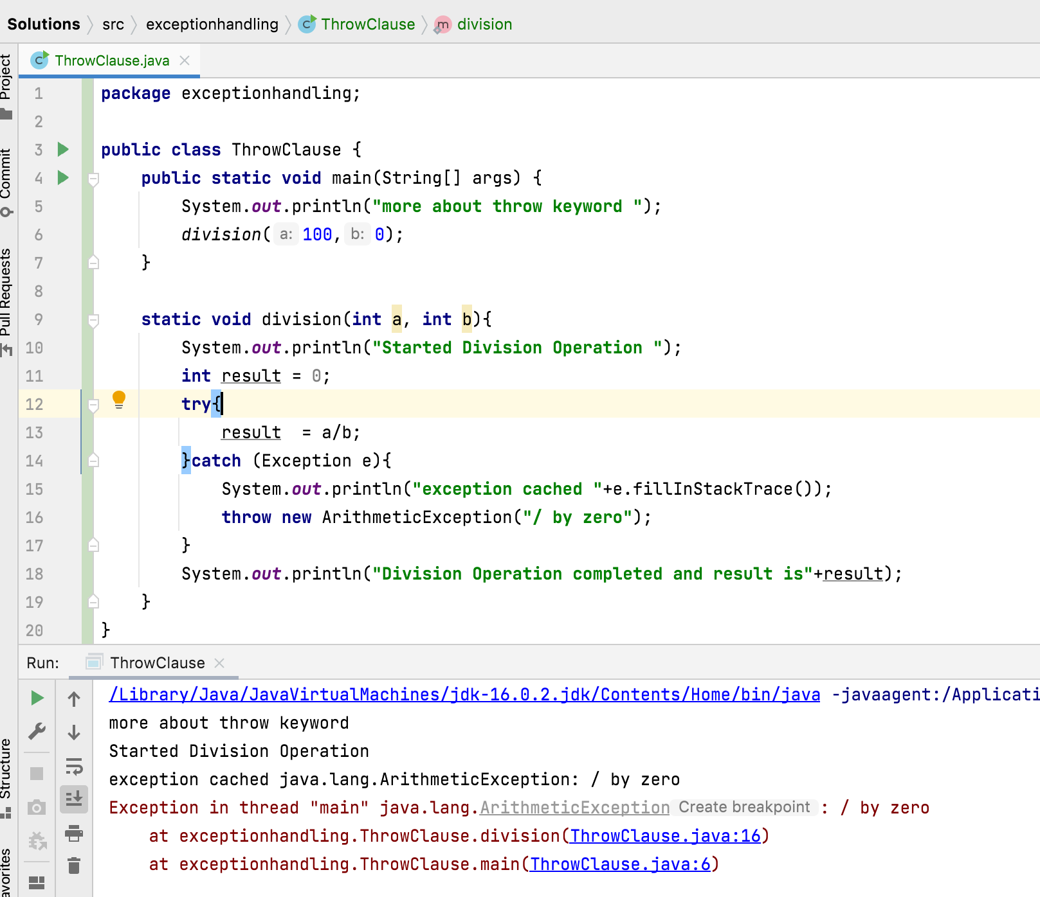
Exceptions occurred in the try block are caught in catch block. Thus, caught exceptions can be re-thrown using throw keyword.
Note: Explicitly thrown exception must be handled some where in the program, otherwise program will be terminated.

Slide 8

Thank You !
momedaram

